Slide 1
MPC and LQR Control of a Bipedal Robot
Kwasi Debrah-Pinamang

Slide 2
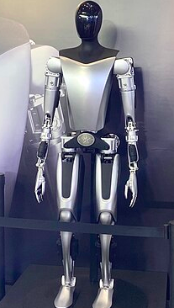
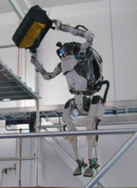
Problem Statement
The goal of this project is to analyze and design two control algorithms for the trajectory planning and control of a bipedal robot
The two control methods that I will mainly be focusing on are Model Predictive Control (MPC) and Linear Quadratic Regulation (LQR)
The inspiration behind this project is due to the rising influence of bipedal robots in current robotics research, as well as the potential applications for this class of robot
Tesla - Optimus
Boston Dynamics - Atlas

Slide 3
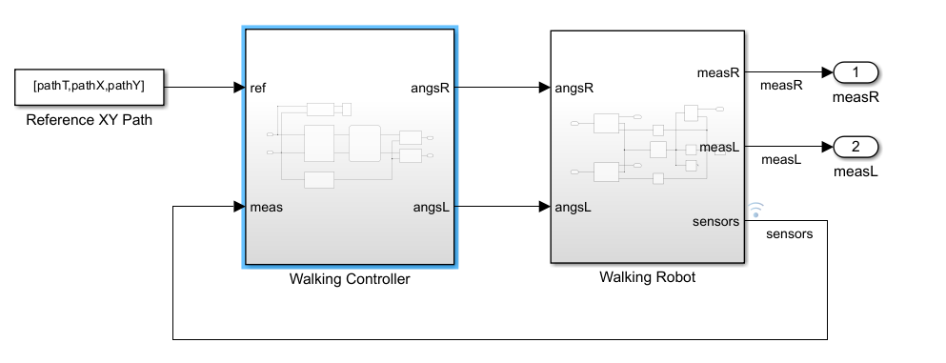
Robot Description & Parameters
The robot model used in this project comes from a Mathworks (Matlab) repository
This repository contains a bipedal robot model as well as several tools for the design and simulation of control systems, which I utilized in this project
The control system for the bipedal robot takes the following form, with this project mainly interfacing with the walking controller block

Slide 4
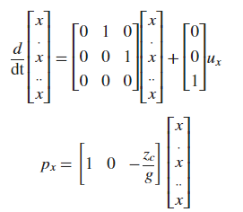
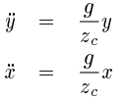
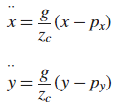

MPC Algorithm Design
A bipedal robot can be thought of as an inverted pendulum, allowing us to construct our equations of motion
Furthermore, we can use our equations of motion to construct our state space representation
We use Matlab’s ss function to generate our state space model after obtaining matrices A, B, C, and D
With our state space, representation, we can discretize the system and begin to design our MPC controller
We discretize the system using Matlab’s c2d function
This provides us with the plant that we will use for the MPC controller
State Space Representation
EoMs with ZMP (zero moment point as output)
General EoMs

Slide 5
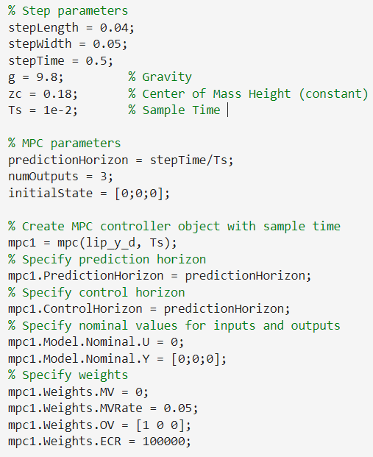
MPC Algorithm Design (cont’d)
To obtain our MPC controller, we will use the discretized plant and the sample time value into the MPC() function
After creation of the MPC object, we can set its parameters
Details on MPC parameters:
Prediction & control horizon - determines number of future steps for system behavior and control input computation
Weights - specifies importance of objectives in control system
Manipulated variable (MV) - variable(s) that can be modified to change system behavior
Output variable (OV) - variable(s) that are being measured
External Covariance Reset (ECR) - simply, it’s used to improve stability and performance in the controller, mainly in the case of disturbances

Slide 6
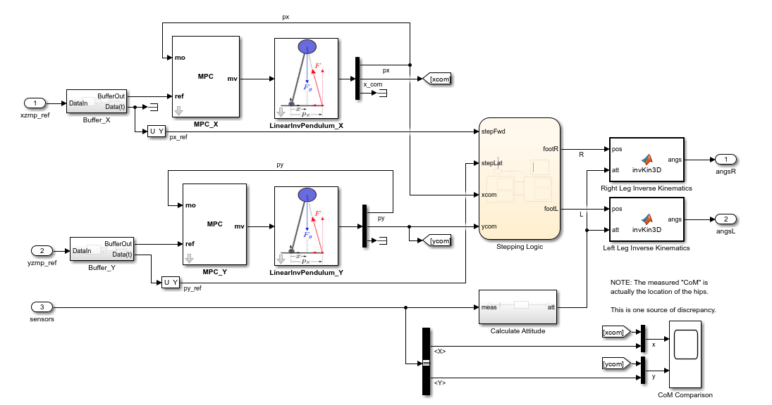
MPC Simulink Model
From within the walking controller block mentioned earlier, we have the following for the MPC implementation:

Slide 7

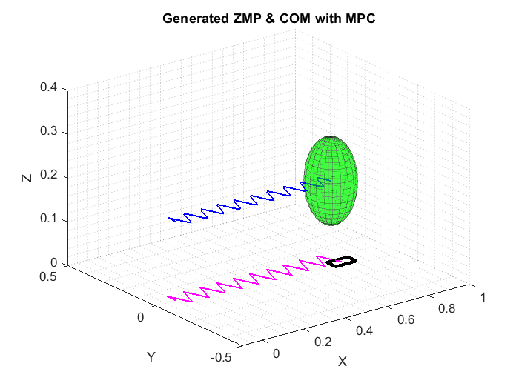
MPC Results

Slide 8
LQR Control Algorithm Design
For our LQR implementation, we can implement our own LQR function and utilize the function in Simulink
We can modify one of the repository’s Simulink models in order to incorporate our LQR function
For our LQR function, we use a simplified version of the earlier state space model and only have one input and output: x or y
The purpose of this instance is primarily to control the x and y acceleration within the walking controller

Slide 9
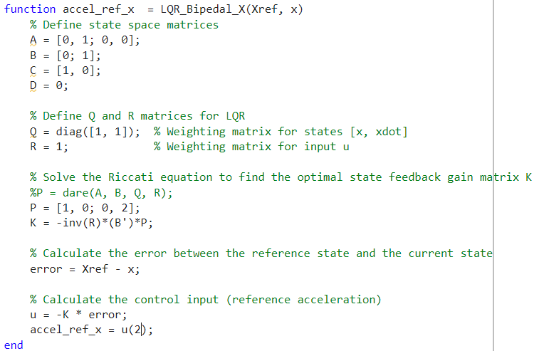
LQR Control Algorithm Design (cont’d)
The code for our LQR algorithm is the corresponding image
Due to issues with Simulink, I did not use the lqr() function and instead utilized the Algebraic Riccati Equation (ARE) in order to calculate K
I did, however, use dare() to calculate P in order to streamline the solving of the ARE

Slide 10
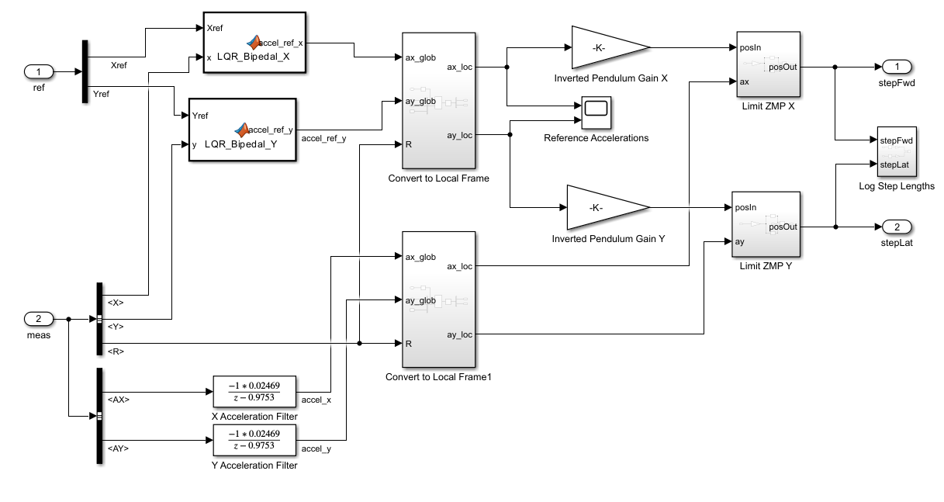
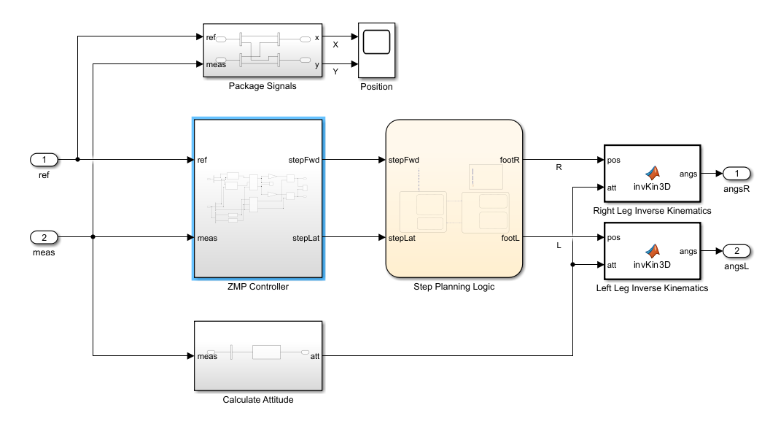
LQR Simulink Model
From within the walking controller block mentioned earlier, we have the following for the LQR implementation:
Full block for walking controller
LQR addition in ZMP controller

Slide 11
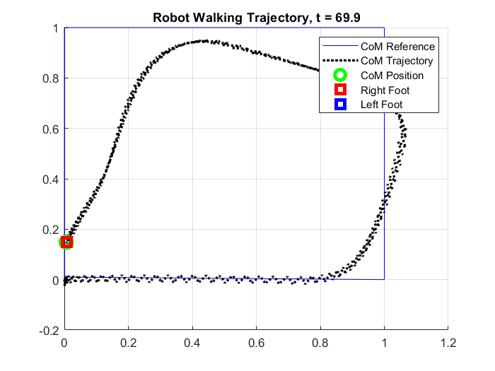
LQR Results

Slide 12
MPC & LQR Comparison
Based on the earlier simulations and these graphs, it appears that the MPC algorithm was better at line/path following while the LQR algorithm seemed to possess overall better gait
It is hard to definitively say which algorithm is “better”, but it can be inferred that each control algorithm is better suited to certain problems

Slide 13
Final Words & Further Work
While this project provided a good benchmark for the two control algorithms, I believe more testing and analysis could help to find out which algorithm provides us with a better solution for this problem
The main thing that could be done is further tuning of both control algorithms
In addition, testing the control algorithms on various trajectories could help to further determine the validity
Lastly, having some form of numerical/statistical data to compare between the two algorithms would help in the comparison

Slide 14
References
Mathworks msra-walking-robot repository: https://github.com/mathworks/msra-walking-robot
Boston Dynamics - Atlas: https://bostondynamics.com/atlas/
Tesla - Optimus: https://en.wikipedia.org/wiki/Optimus_(robot)
Paper on modeling of 3D Linear Inverted Pendulum: https://www.cs.cmu.edu/~hgeyer/Teaching/R16-899B/Papers/KajiitaEA01IEEE_ICIRS.pdf
Documentation on Matlab’s MPC controller: https://www.mathworks.com/help/mpc/ref/mpc.html#mw_105d5b49-23a3-4b54-a58c-935e3e47eb03
Documentation on Matlab’s LQR controller: https://www.mathworks.com/help/control/ref/lti.lqr.html

